Slide 1

C++ & DSA PLACEMENT COURSE
Khaiser Khanam

Slide 2

SPACE COMPLEXITY

Slide 3



Memory ?
Space Complexity.

Slide 4
Space Complexity Definition
Space Complexity = Kitni extra memory aapka program use karta hai run time mein.
Ismein input data count nahi hota — sirf extra variables, arrays, stacks, recursion ka memory count hota hai.

Slide 5

Total Space = Input Space + Auxiliary Space
Auxiliary Space matlab extra memory jo aapka program run hone ke time par khud se allocate karta hai — kisi additional data structure ya variable ke liye.
Ismein input size count nahi hota.

Slide 6






Slide 7



Tum 10 books leke jaa rahe ho — memory = O(n)
Tum sirf pen leke jaa rahe ho — memory = O(1)
Tum har subject ke liye alag bag leke jaa rahe ho — O(n²)!

Slide 8
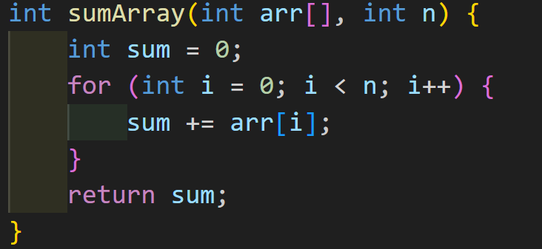
Calculate Space Complexity

Slide 9
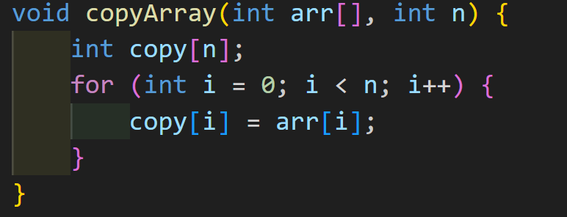
Calculate Space Complexity

Slide 10
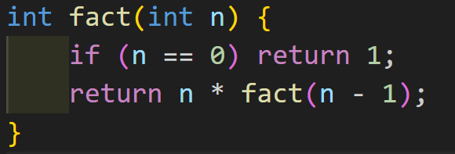
Calculate Space Complexity

Slide 11
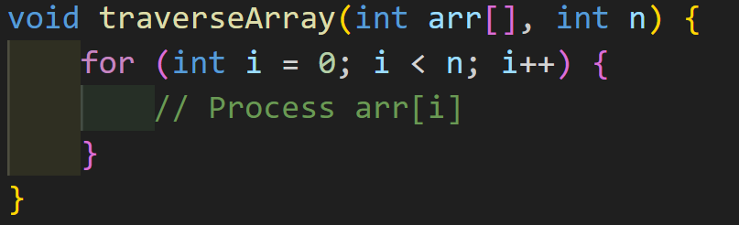
Calculate Space Complexity

Slide 12
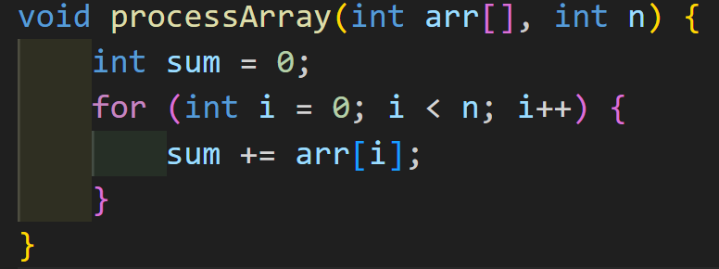
Calculate Space Complexity

Slide 13
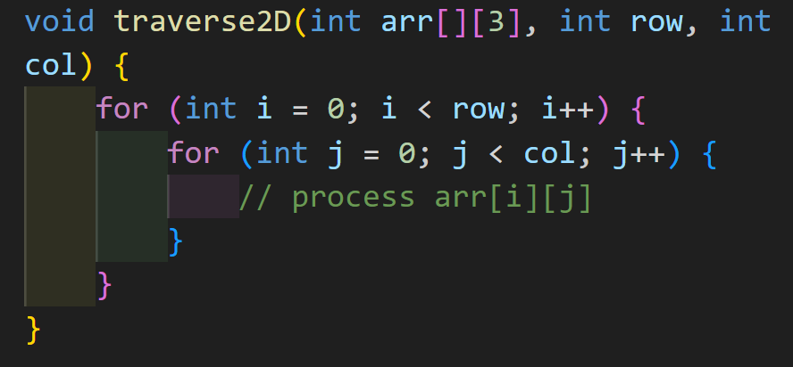
Calculate Space Complexity

Slide 14


Time Complexity ya Space Complexity?
Time Complexity
Time = 1 second
Space = 1 GB RAM
Time = 5 second
Space = 10MB
"99% cases mein humein Time Complexity ko zyada mahatwa dena chahiye!"

Slide 15




Time
Stock Trading
Games
Live
Chat
Slow App

Slide 16



Space
Memory limited ho

Slide 17


Project ke goal ke hisaab se aap decide karoge kaun better hai

Slide 18
If your app is too slow → Optimize time
If your app crashes due to memory → Optimize space

